Slide 1





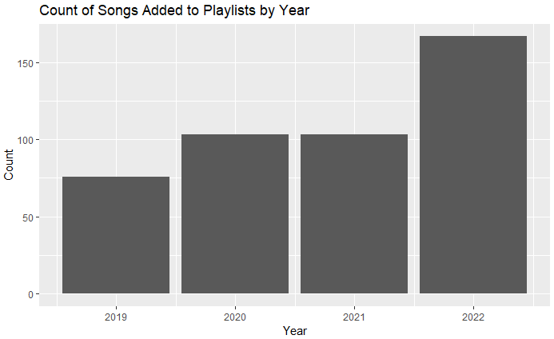
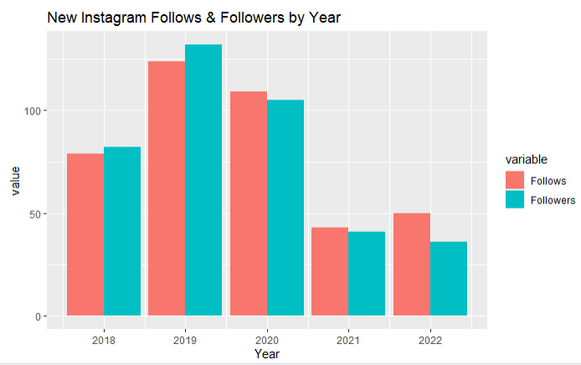
Eric Infographic
Google Drive (files edited)
2020: 32, 2021: 25, 2022: 51
Pictures Taken (phone)
2019: 467, 2020: 233, 2021: 542, 2022: 365
Google Classrooms
2020: 2, 2021: 1, 2022: 1
Spotify (minutes played)
2021: 9334.85 (~6.5 days)
2022: 22054.15 (~15.25 days)
Spotify (songs added to playlist)
2019: 76, 2020: 103, 2021: 103, 2022: 167
Instagram (new followers)
2018: 82, 2019: 132, 2020: 105, 2021: 41, 2022: 36
Instagram (new follows)
2018: 79, 2019: 124, 2020: 109, 2021: 43, 2022: 50

